Slide 1
Real-Time Face Mask Detection Using YOLOv5
By: WAMAV Coders (Group 6)
AI Course
Notes:
Note:

Slide 2
Index
UNIT 1. Introduction
UNIT 4. Conclusion
1.1. Background Information
1.2 Motivation and Objective
4.1. Accomplishments & Benefits
4.2 Future Improvements
UNIT 2. Execution
2.1. Data Acquisition
2.2. Training Methodology
2.3. About YOLOv5
2.4. Workflow
UNIT 3. Results
3.1. Data Preprocessing
3.2. Modeling
3.3. Final Product
Notes:
Note:

Slide 3
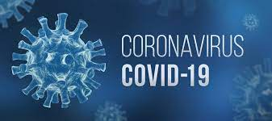
UNIT 1.
Introduction
1.1 Background
The COVID-19 pandemic has caused a global health crisis. In response, the World Health Organization (WHO) has suggested wearing a face mask in public for effective protection. While much of the global population has adhered to these recommendations, some continue to wear the face mask improperly or refuse to wear the mask at all. It is essential that face masks are properly worn in public.

Slide 4
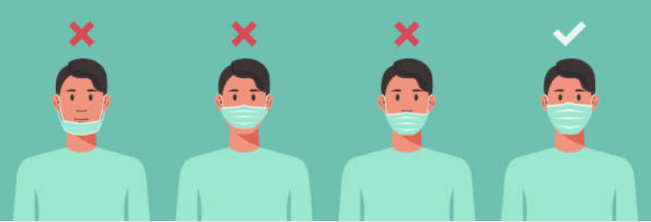
UNIT 1.
Introduction
1.2 Motivation and Objective
Since the breakout of the deadly virus, COVID -19 has become the worst health problem that has affected the world population.However, wearing a face mask that inhibits the spread of droplets in the atmosphere can still help combat this pandemic. Therefore, we aim to develop a real-time face mask detector using deep learning techniques that can be deployed for public use. The design uses the latest Yolov5 and PyTorch for the implementation. The work mainly detects three types of wearing face masks; Person wearing the mask, Person not wearing the mask, and Person not correctly wearing the mask.

Slide 5
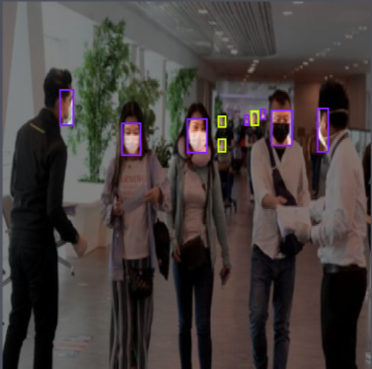
UNIT 2.
Execution
2.1 Data Acquisition
The data set is taken from Kaggle and annotated using Roboflow
The data set is number of images with 3 categories (“with mask” ,”without mask”, ”mask worn incorrectly”)
Annotated image

Slide 6
UNIT 2.
Execution
2.2 Training Methodology
The dataset was divided into 3 parts train / validate /test in the ratio of (70/20/10)%.
‘train.py’ file included in YOLOv5 model was used to train the model.
200 epochs were used to train the model.
Image size used is 416 x 416 .

Slide 7
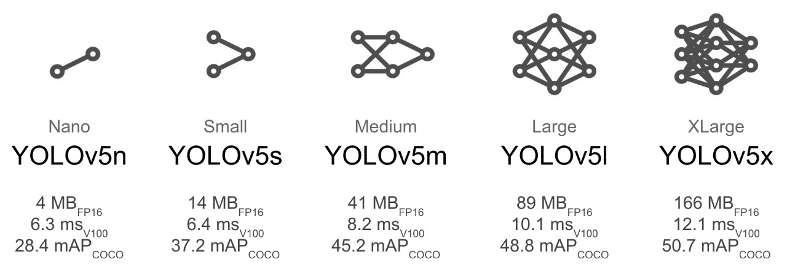
UNIT 2.
Execution
2.3 About YOLOv5
Yolo – You Only Look Once
Yolo(1-5)
The algorithm is used in many applications because of its faster detection and accuracy.
YOLO-v5 is an open-source project by Ultralytics that constitutes a group of several object detection models and techniques based on the YOLO model, pre-trained on the COCO dataset with 80 pre-labelled classes.
Uses PyTorch
They can be used for real-time object detection based on the data streams.
They require very few computational resources.
YOLOv5 model options

Slide 8
UNIT 2.
Execution
2.4 Workflow
Installing dependencies required by YOLOv5
Downloading annotated data from roboflow
Reviewing the number of classes
Training the data
Custom loading the model
Testing on a random image from google.com
Implementing real time mask detection using webcam

Slide 9
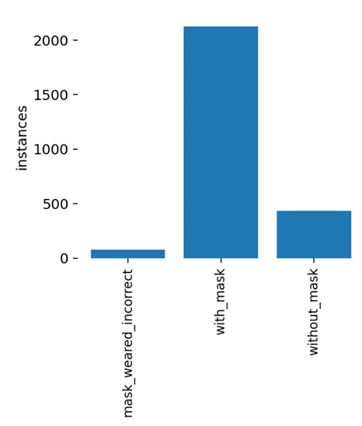
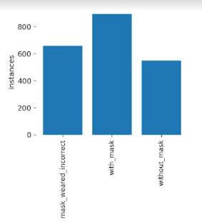
UNIT 3.
Results
3.1. Data Preprocessing
3.1.1. Handling imbalanced data
Using only one dataset resulted in an imbalanced model as the number of instances per class heavily varied from class to class. Therefore, an additional dataset was added and a few with_mask instances were removed.
Imbalanced Data
Balanced Data

Slide 10
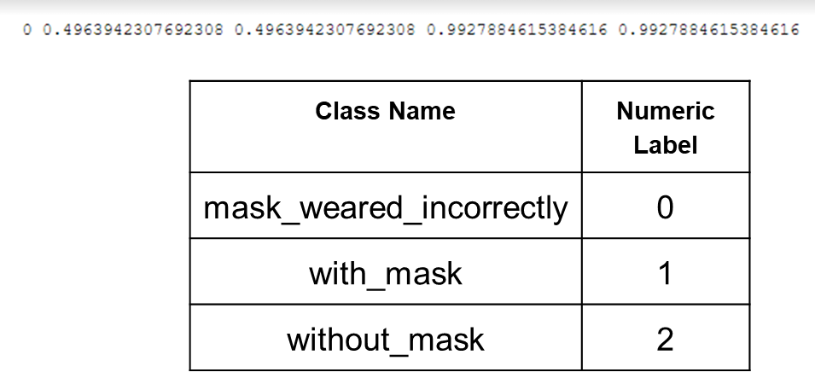
UNIT 3.
Results
3.1. Data Preprocessing
3.1.2. Data annotation on Roboflow
One of the datasets already consisted of annotations in XML format. These needed to be converted to TXT, this was done using Roboflow. The other dataset consisted of unannotated images, which were annotated and exported in YOLOv5 txt format on Roboflow.
Annotation example and class numeric labels

Slide 11
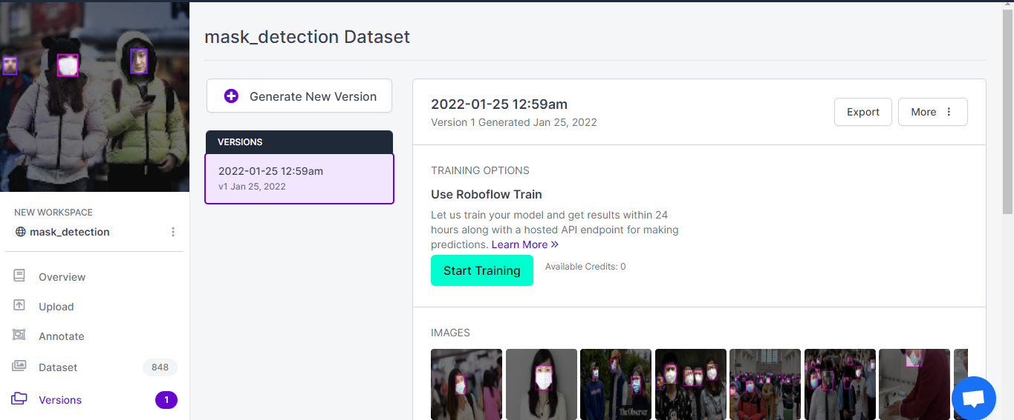
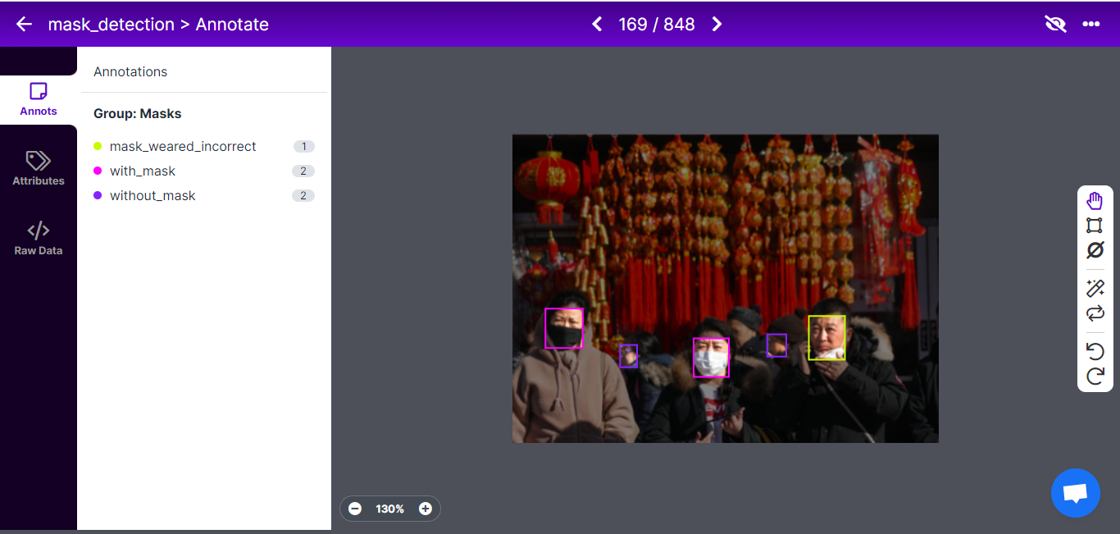
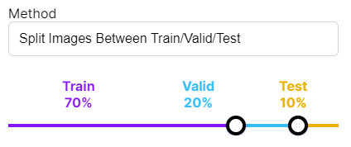
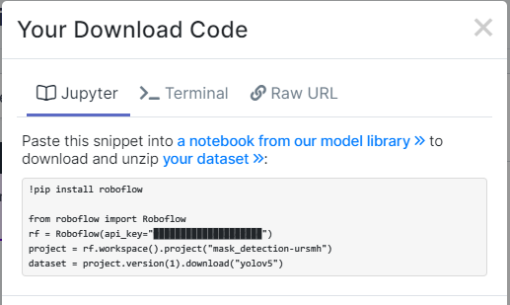
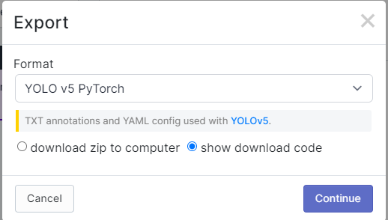
UNIT 3.
Results
3.1. Data Preprocessing
3.1.2. Data Annotation on Roboflow
1. Create Dataset and Import images
2. Annotate the instances for each image
3. Split the dataset
5. Obtain the private key to the dataset
4. Export in YOLOv5 txt format

Slide 12
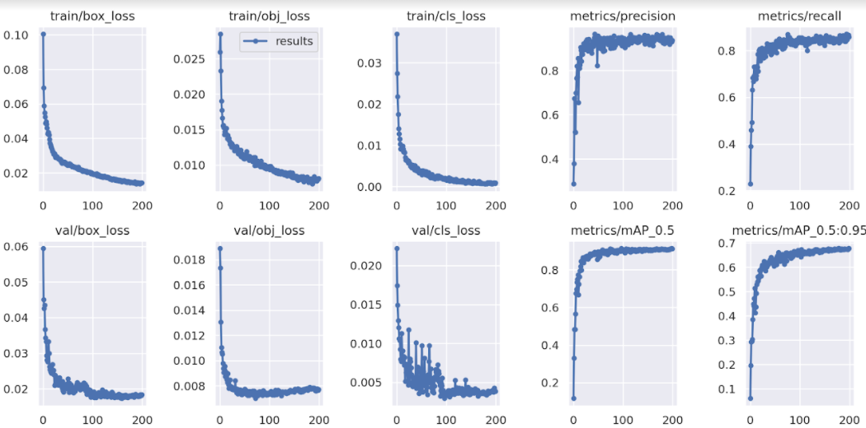
UNIT 3.
Results
3.2. Modeling
3.2.1. Results of the YOLOv5 Model Training & Validation through Epochs
Box loss denotes the performance of the algorithm with reference to the bounding box.
The Objectness loss represents the probability that an instance exists in a proposed region of interest.
The classiﬁcation loss gives knowledge of the algorithm predicting the right class of a given instance.
Model training and validation results

Slide 13
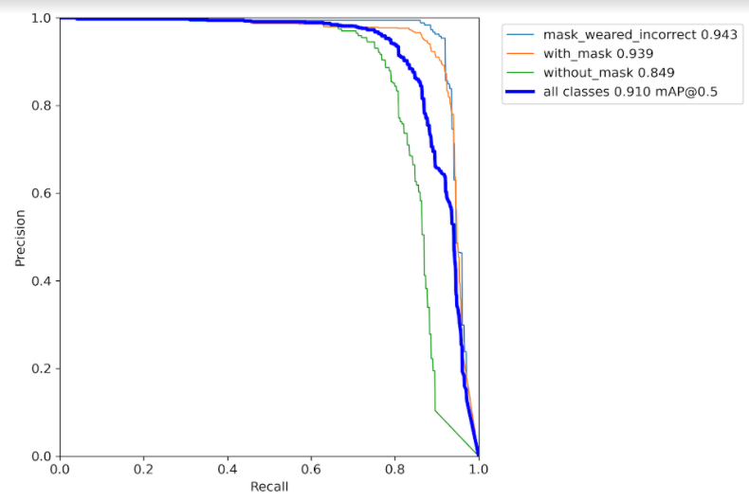
UNIT 3.
Results
3.2. Modeling
3.2.2. PR Curve
The best PR curve threshold is one that results in the precision and recall being closest to 1. Therefore, from the key, of the PR curve shown in the figure, it can be seen that the precision-recall threshold is fairly high for all of the classes.
PR Curve

Slide 14
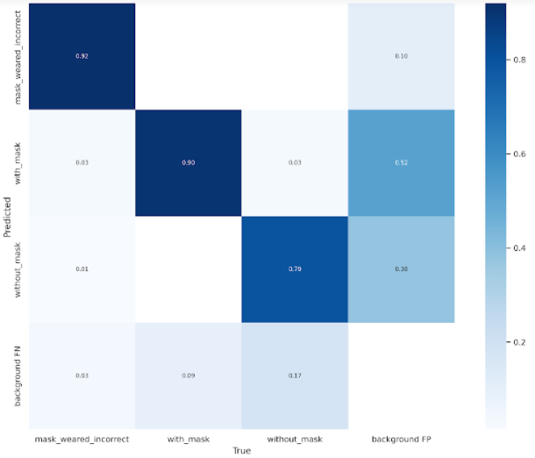
UNIT 3.
Results
3.2. Modeling
3.2.3. Confusion Matrix
A confusion matrix is used to evaluate the performance of a classification model. The figure above depicts that the true positive rate is high (0.92 for mask weared incorrect, 0.90 for with mask and 0.79 for without mask) for all three classes. This rate defines the proportion of the predicted classes that were actually those classes.
Confusion Matrix

Slide 15

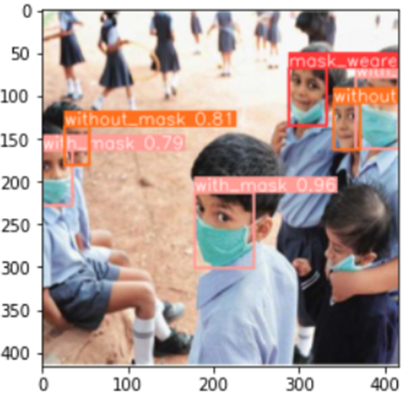

UNIT 3.
Results
3.3. Final Product
It is essential to test the classifier with images outside from the dataset that was used to train, test and validate the model. The image shows that this classifier has correctly identified the target class for each instance with a fairly high confidence.

Slide 16
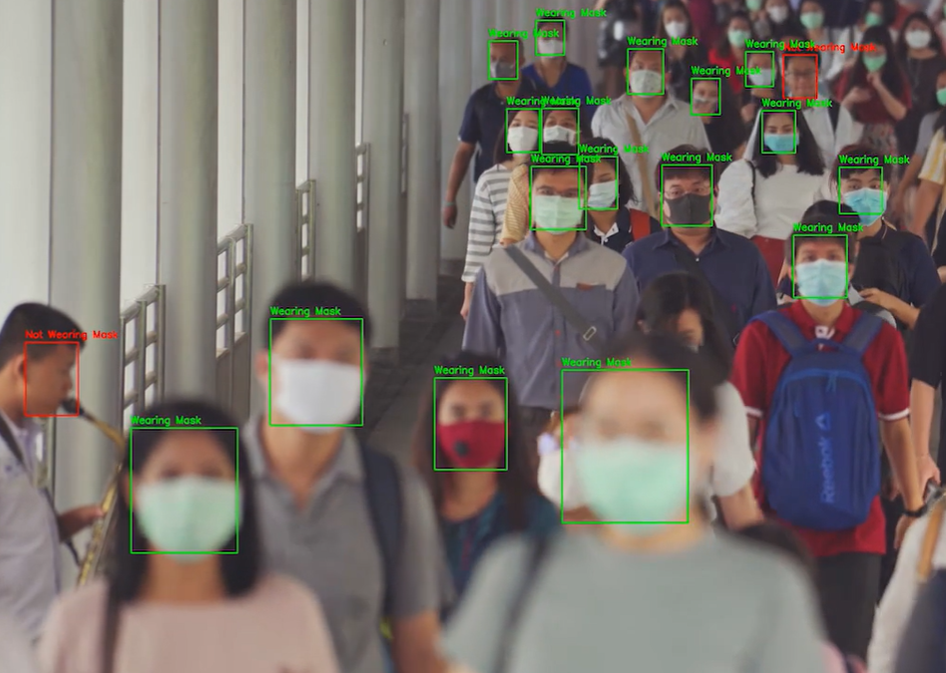
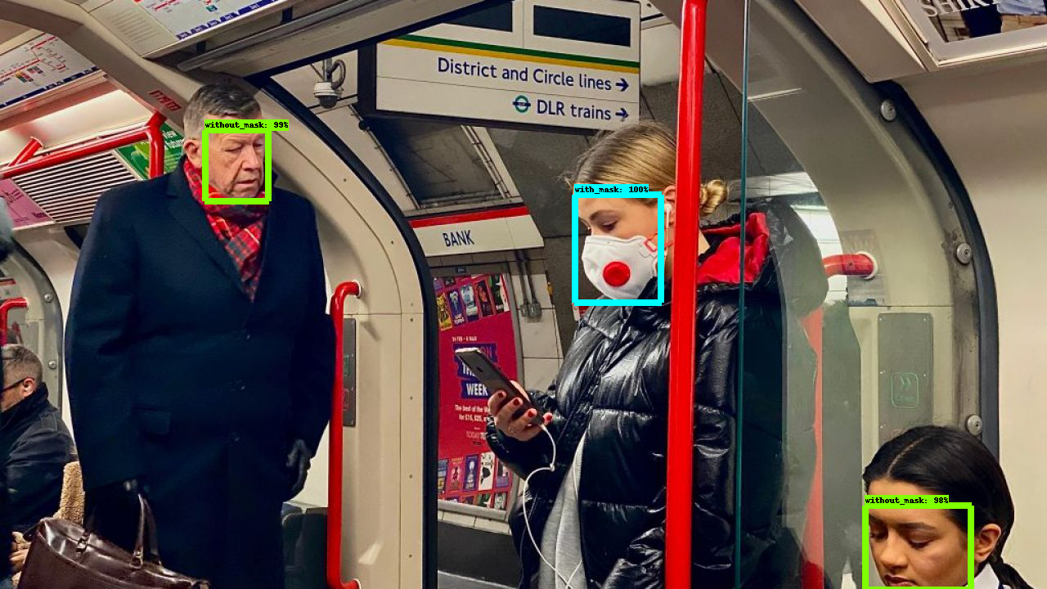
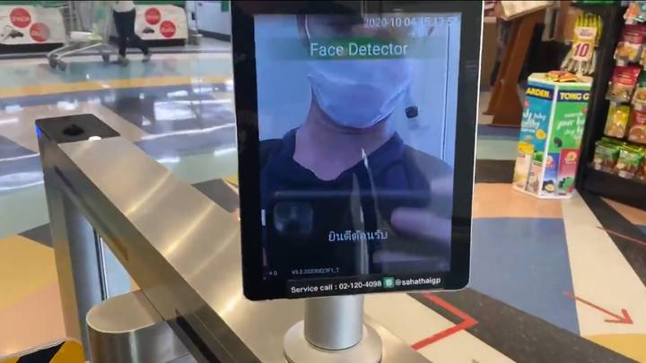
UNIT 4.
Conclusion
4.1. Accomplishments & Benefits
Attained an accuracy of 85 % on detecting the correct wear of masks
Most models detect either with face mask or without face mask but this model detects incorrectly worn mask as well.
Easy and cheap to implement
Can be used at entrances of various public places like hospitals, offices, schools etc

Slide 17
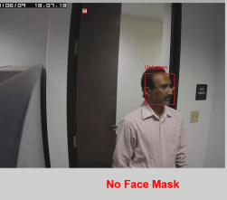
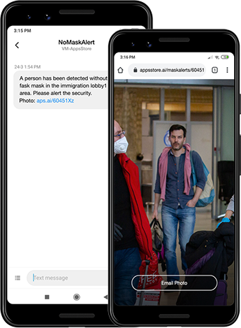
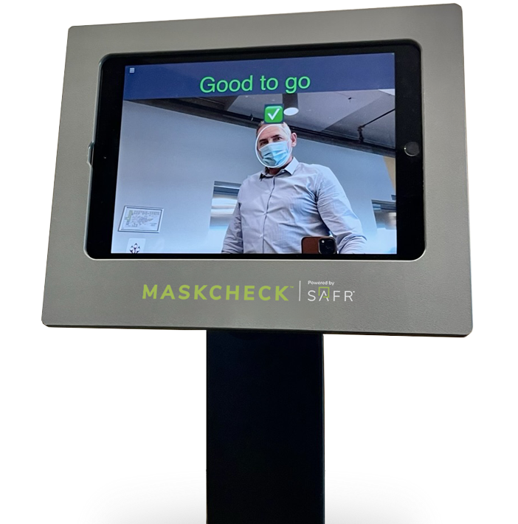
UNIT 4.
Conclusion
4.2. Future Improvements
Detection of faces of the not directly facing the camera.
Integrated into CCTVs at public places
Give intimation warnings to those not wearing face masks or wearing it incorrectly
Created into an application for the local governments and police stations that will notify them about the number of people wearing face masks and not wearing face masks

